Slide 1

Strategic Business Plan 2019

Slide 2

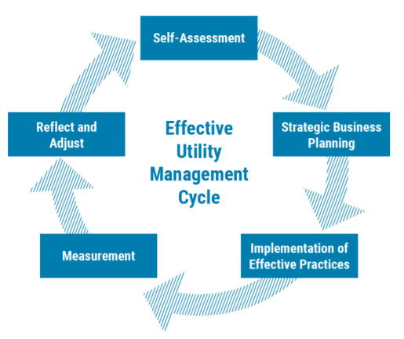
“Water and wastewater utilities can use the Attributes to select priorities for improvement, based on each organization’s strategic objectives and the needs of the community it serves.”

Slide 3
Self Assessment
Ten Attributes of Effectively Managed Utilities
Rank Achievement Level – 1-5 Scale
Rank Importance – 1-10 Scale

Slide 5



Financial Viability
Operational Optimization
Infrastructure Strategy and Performance
Establishes and maintains an effective balance between long-term debt, asset values, operations and maintenance expenditures, and operating revenues.
Ensures ongoing, timely, cost-effective, reliable, and sustainable performance improvements in all facets of its operations in service to public health and environmental protection.
Plans infrastructure investments consistent with community needs, anticipated growth, system reliability goals, and relevant community priorities, building in a robust set of adaptation strategies (e.g., for changing weather patterns, customer base).
Notes:
Most Important Attributes – Descriptions from EUM Primer

Slide 6



Community Sustainability
Employee Leadership and Development
Enterprise Resiliency
Integrates water resource management with other critical community infrastructure, social and economic development planning to support community-wide resilience, support for disadvantaged households, community sustainability, and livability.
Recruits, develops, and retains a workforce that is competent, motivated, adaptive, and safety focused.
Proactively identifies, assesses, establishes tolerance levels for, and effectively manages a full range of business risks (including interdependencies with other services and utilities, legal, regulatory, financial, environmental, safety, physical and cyber security, knowledge loss, talent, and natural disaster-related) consistent with industry trends and system reliability goals.
Notes:
Attributes Requiring Improvement – Descriptions from EUM Primer

Slide 7

“Water and wastewater utilities can use the Attributes to select priorities for improvement, based on each organization’s strategic objectives and the needs of the community it serves.”

Slide 8
Strategic Business Planning
Mission Statement
Objectives
Initiatives

Slide 9
Mission Statement
It is the mission of the Brunswick-Glynn Joint Water and Sewer Commission to safeguard the public health and safety by providing sufficient drinking water and environmentally responsible wastewater treatment in a financially sound manner while meeting or exceeding all regulatory requirements and supporting planned growth in the community.

Slide 10
Key Concept Categories
Responsible Decision Making
Customer Service
--Expand strategic asset management program
--Improve budget controls for each operating division
--Improve inventory control measures
--Decrease maintenance inefficiencies
--Improve public trust with values-based customer service
--Ensure customer billings are equitable
--Work to make monthly bills more affordable for low-income customers
--Provide consistent information to the customer base
Environmental Compliance
Community Resource
Workforce Development
--Maintain regulatory compliance with all permits
--Educate public on compliance efforts and results
--Reduce business down time from boil water advisories
--Improve sewer capacity through I&I reduction
--Educate community on value of water and wastewater services
--Facilitate simpler development practices
--Determine where system expansion should be prioritized
--Eliminate sewer capacity issues before they become roadblocks
--Ensure continuing education requirements are met for credentialed employees
--Provide consistent training for non-credentialed staff
--Improve employee safety through training and auditing
--Document institutional knowledge of tenured employees

Slide 11
“Water and wastewater utilities can use the Attributes to select priorities for improvement, based on each organization’s strategic objectives and the needs of the community it serves.”

Slide 12
Calendar Year 2019 Strategic Initiative Timeline
January
December
Notes:
Bunched together intentionally at beginning and spread out at end to show quick progress then more time consuming initiatives at end

Slide 13
Clearly Define Organizational Values
Monthly Compliance Campaign
Monthly Operating Budget Review Meetings
Continuing Education Requirements Audit
Plan Development Review Workflow Mapping
First Quarter Initiatives

Slide 14
Customer Payment Assistance Program
Monthly Work Group with Local
Authorities
St Simons Island Smoke Testing
Learning Management System for
All Personnel
Weekly Maintenance Planning
Second Quarter Initiatives

Slide 15
Safety Council Site Visits
Pump Station Flow Meter Installation
Customer Database Audit
and Analyses Program
Value of Water Public Education
Campaign
Galvanized Water Main
Replacement Program
Third Quarter Initiatives

Slide 16
St. Simons Island Gravity Sewer
Assessment Report
Workflow Mapping Program
Warehouse Job Boxes
Large Meter Testing Program
Updated Sewer Capacity Maps
Fourth Quarter Initiatives

Slide 17
Example Initiative
Weekly
Maintenance
Planning

Slide 18
Weekly Maintenance Planning
Strength
Threat
Software in place to facilitate advanced planning and scheduling
Staff growing in their knowledge of capabilities of software
Improves staff accountability
Allows for reduction in equipment downtime
S
Lack of employee buy-in
Learning curve for employees could take longer than anticipated
Rigid scheduling practices can harm customer service efforts
W
SWOT
T
Weakness
Opportunity
Time consuming for staff to implement properly
Requires behavioral changes of both superintendents and staff
Increases reliance on and cost of IT infrastructure
Improved productivity and efficiency in operations
Increased resource sharing among divisions
Can provide proactive customer support
More efficient tracking of resource use
O
Notes:
Example SWOT for Weekly Maintenance Planning

Slide 19
Weekly Maintenance Planning
87%
KPI #1
KPI #1
% of Maintenance Work Planned/Preventative
KPI #2
% Cost of Maintenance Work Planned/Preventative
KPI #3
% Maintenance Labor Utilization
KPI #4
% of Preventative/Planned Work Orders Completed on Schedule
68%
KPI #2
2019
50%
KPI #3
43%
KPI #4
Notes:
KPIs for Weekly Maintenance Scheduling

Slide 20
“Water and wastewater utilities can use the Attributes to select priorities for improvement, based on each organization’s strategic objectives and the needs of the community it serves.”

Slide 21
Next Steps
Quarterly KPI Updates
See Progress
Adjust as Data Suggests

Slide 22
Customer Focused
Community Aligned
Transparent & Accountable
Value & Invest in Employees
Continually Strive for Improvement
Positive Can-Do Engagement
Company Culture –
Core Values

