Slide 1
Strategic Plan Development BGCJWSC
October 2017

Slide 2
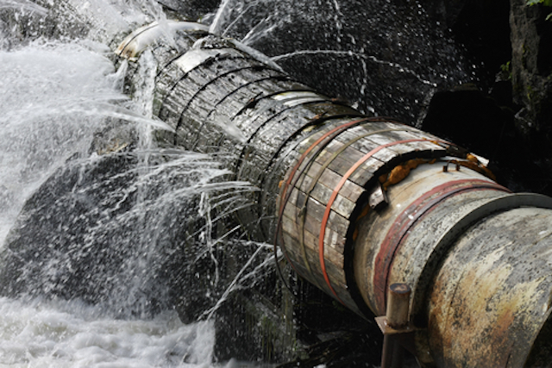
Why perform this exercise?
Aging and/or failing infrastructure
Outdated and obsolete technologies
Consent orders insinuated by EPD
Increased threat of SSOs in the system
Frequent water main breaks
Impacts to Customers:
Health and safety
Loss of water supply
Environmental consequences from lack of wastewater treatment
Higher operating costs from O&M for aging systems
Newer and hardened assets will provide more resiliency

Slide 3
Investing today will reduce overall maintenance costs WITH TIME

Slide 4
Presentation OVERVIEW
EUM Methodology Overview
Examples of Strategy aligning with an attribute followed by a practice area with objectives, goals, and metrics
Elements of the Strategic Plan and Implementation Cost and Schedule

Slide 5
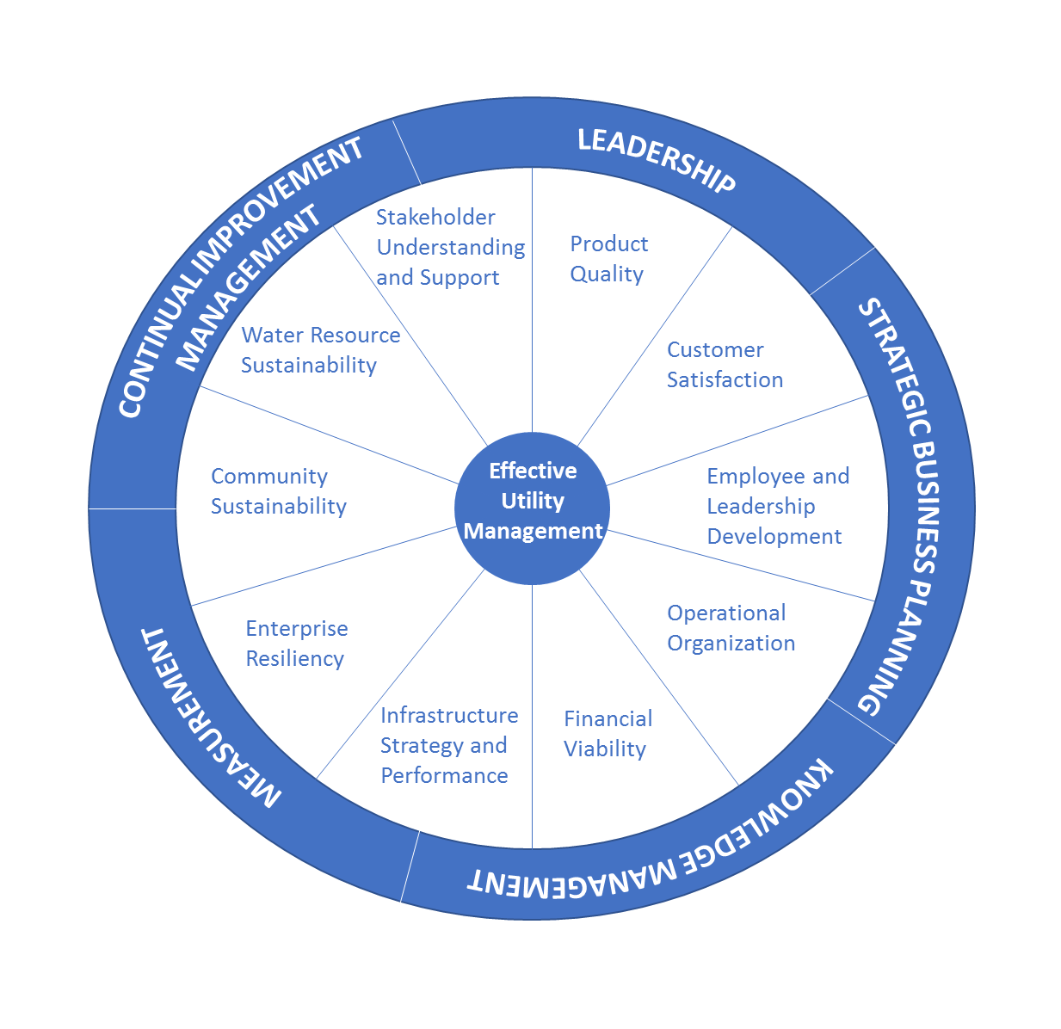
EUM METHODOLOGY PROVIDES A 360-DEGREE APPROACH FOR UTILITY MANAGEMENT AND MEASUREMENT OF PERFORMANCE
** EUM or Effective Utility Management Methodology is commonly used by WEF and AWWA

Slide 6
EUM Attributes
Product Quality Customer Satisfaction Employee and Leadership Development Operational Optimization Financial Viability | Infrastructure Strategy and Performance Enterprise Resiliency Community Sustainability Water Resource Sustainability Stakeholder Understanding and Support

Slide 7
Attributes of an effectively managed utility
Product Quality
Produces “fit for purpose” resources that meet or exceed full compliance with regulatory and reliability requirements and consistent with customer, public health, ecological, and economic needs.
Customer Satisfaction
Provides reliable, responsive, and affordable services in line with explicit, customer-driven service levels.
Stakeholder Understanding and Support
Engenders understanding and support from stakeholders (anyone who can affect or be affected by the utility)

Slide 8
Attributes of an effectively managed utility
Financial Viability
Understands and plans for the full life-cycle of utility operations and value of water resources.
Operational Optimization
Ensures ongoing, timely, cost-effective, reliable, and sustainable performance improvements in all facets of its operations in service to public health and environmental protection.
Employee and Leadership Development
Recruits, develops, and retains a workforce that is competent, motivated, adaptive, and safety focused.
Establishes and maintains an effective balance between long-term debt, asset values, operations and maintenance expenditures, and operating revenues.

Slide 9
Attributes of an effectively Managed utility
Enterprise Resiliency
Ensures utility leadership and staff work together internally, and coordinate with external partners, to anticipate, respond to, and avoid problems
Infrastructure Strategy and Performance
Understands the condition of and costs associated with critical infrastructure assets.
Community Sustainability
Takes and active leadership role in promoting and organizing community sustainability improvements through collaboration with local partners.
Water Resource Sustainabilty
Ensures the availability and sustainable management of water for its community and watershed, including water resource recover.

Slide 10
As an example, the attribute of infrastructure strategy and performance is considered
Practice
Practice Area 1: New Development
Measure: update development standards by January 1st every year
Practice
Practice Area 2: Capital Delivery
Measure: schedule and budget compliance on a project level and overall level
Measure: Human capital efficiency to deliver
Practice
Practice Area 3: Asset Management
Measure: fixed assets to be inventoried and plan for R&R in place
Measure: assets with moving parts to include programmatic preventive maintenance (CMMS)
Attribute:
Infrastructure strategy and performance
Practice Areas:
New Development
Capital Delivery
Asset Management

Slide 11
Strategy Aligns with an Attribute followed by a Practice area with objective, goals, and metrics
Product Quality
Customer Satisfaction
Employee and Leadership Development
Financial Viability
Infrastructure Strategy and Performance
Operational Optimization
Enterprise Resiliency
Community Sustainability
Water Resource Sustainability
Stakeholder Understanding and Support
Strategies
Goals and Objectives
Metrics
Practice Areas

Slide 12
Water treatment
OBJECTIVE | EUM ATTRIBUTES | METRIC | ESTIMATED COST
Provide reclaimed water for new developments | 8. Water Resource Sustainability 9. Community Sustainability | Glynn County to enact ordinance requiring new development to have reclaimed water service | Assumed by developer, reclaimed water pipelines from WWTP needed
Provide additional storage and pumping in the system (1 day recommended) | 4. Operational Optimization 6. Infrastructure Strategy & Performance | 1.2 MG in the City 2.7 MG in St. Simons Island South Mainland has adequate storage | $6 million
Eliminate flooding at the water supply wells | 4. Operational Optimization Public health | Elevate the wells out of the 1-in-100 or 1-in-500 year flood plain. Confirm well elevations. | 7 wells at $150K per well Budget $1.05 million
Provide reliable monitoring of the wells | 4. Operational Optimization 6. Infrastructure Strategy & Performance | Implement hardware and VT SCADA so that the wells and chemical feed systems can be monitored/controlled remotely | 14 wells at $60K per well $0.84 million
Ensure reliable backup power supply | 4. Operational Optimization 6. Infrastructure Strategy & Performance 7. Enterprise Resiliency | New generators with natural gas supply for all wells Consideration of diesel or propane driven pumps Grounding, UPS, Flood Elevations | 14 wells at $180K per well $2.52 million

Slide 13
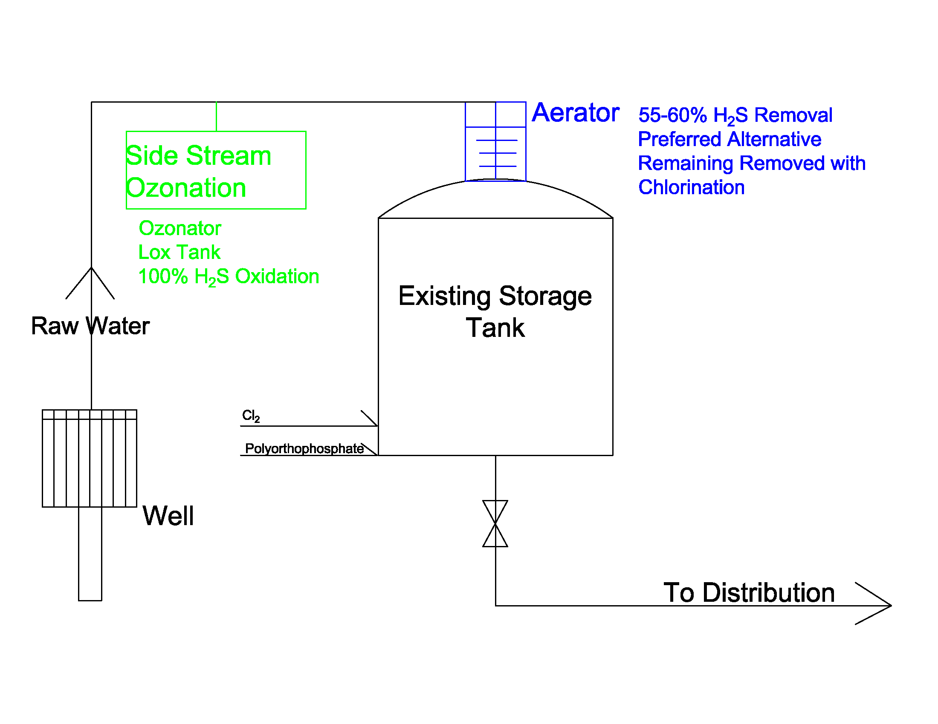
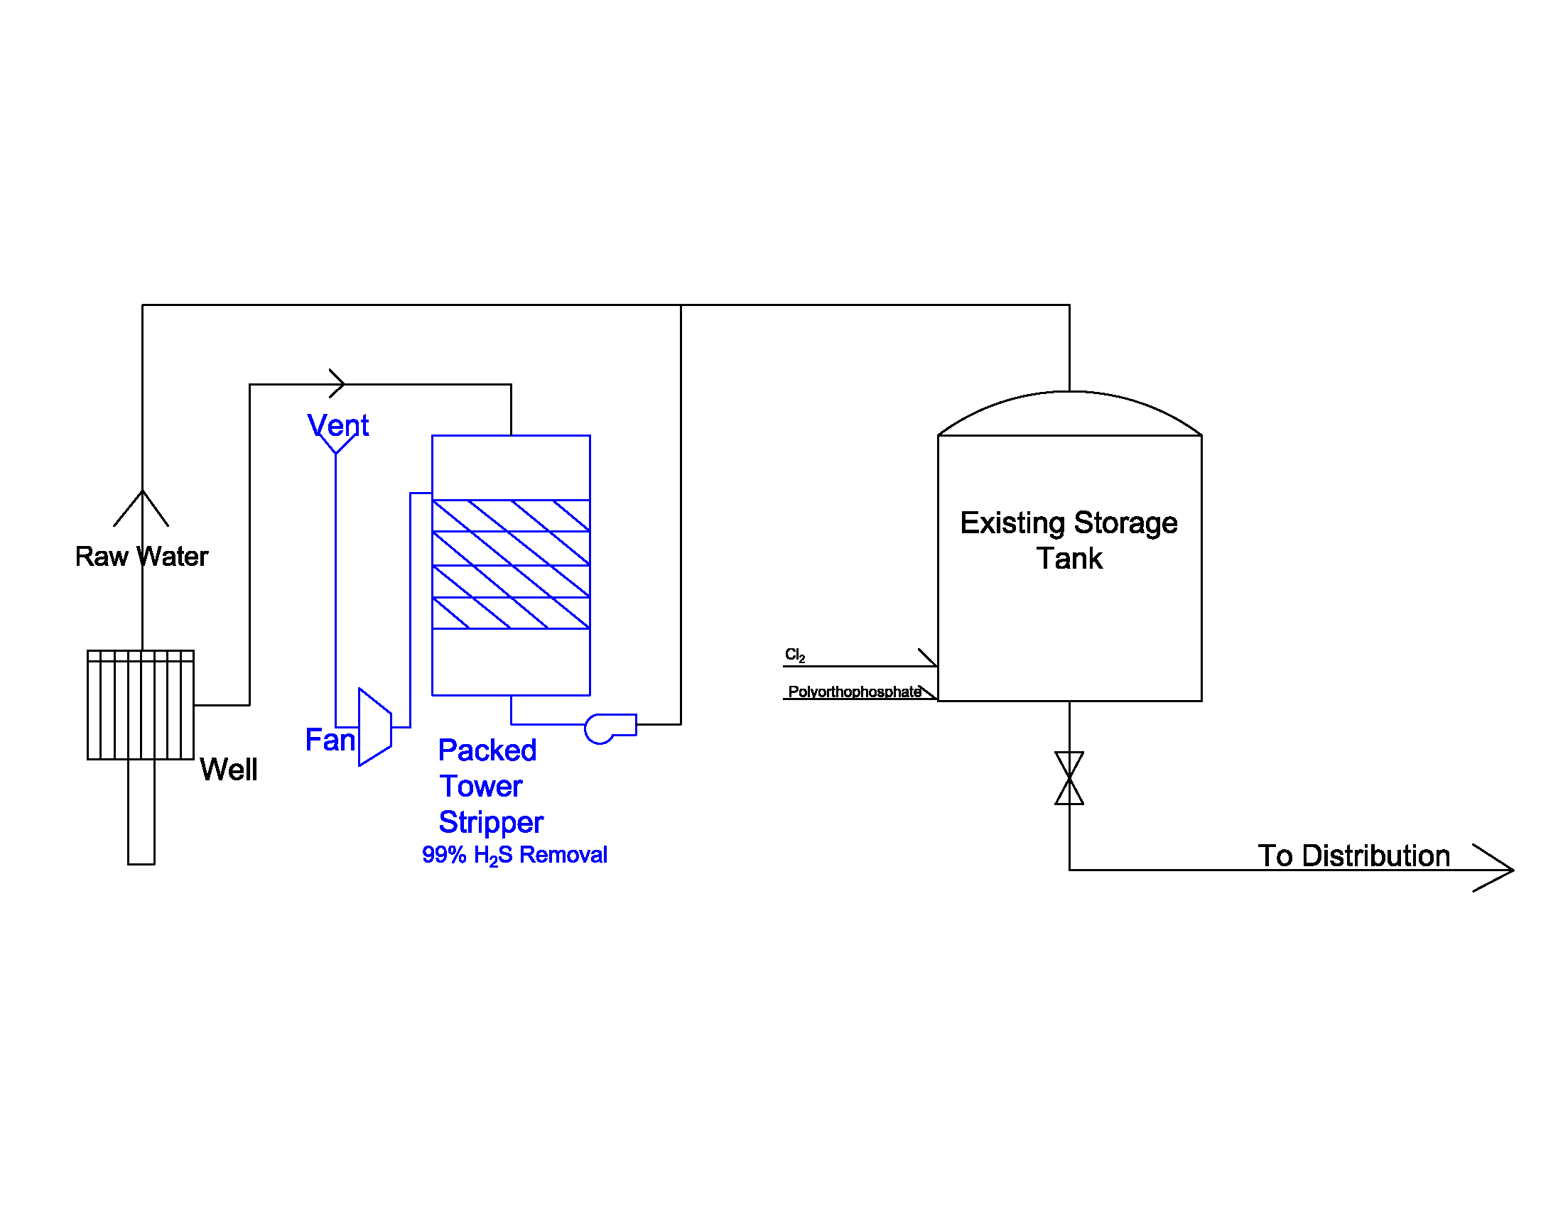
Current water treatment systems are adequate for the foreseeable future

Slide 14
WATER DISTRIBUTION
OBJECTIVE | EUM ATTRIBUTES | METRIC | ESTIMATED COST
Implement a renewal and replacement program for inground assets | 1. Product Quality 4. Operational Optimization 6. Infrastructure Strategy & Performance | Refine and improve asset management program by 2018 Remove and replace Asbestos Concrete Pipe, Cast Iron, Galvanized, and ductile iron pipe in that order 4-inch and above is well inventoried, <4-inch not well cataloged | 20% of Asset Value of $150 million at $30 million $3 million per year-10 years
Accurately measure and bill for water | 2. Customer Satisfaction 5. Financial Viability 10. Stakeholder Understanding & Support | Continue AMR implementation Consider testing meters for accuracy based on age and on a programmatic basis | Included in master plan
Minimize water quality challenges from hydrant testing | 1. Product Quality 4. Operational Optimization 6. Infrastructure Strategy & Performance 9. Water Resource Sustainability | Hydrant testing responsibility to be assumed by BGCJWSC | 1 new crew full time $250K per year
Develop understanding of the water system | 1. Product Quality 4. Operational Optimization 6. Infrastructure Strategy & Performance 9. Water Resource Sustainability | Develop and maintain hydraulic model for the system and model fireflow demands | Ongoing and being implemented ($150K/year)
Improve water quality | 1. Product Quality 4. Operational Optimization 6. Infrastructure Strategy & Performance 9. Water Resource Sustainability | Provide automatic flushing for all dead ends Provide looping for new development (when possible) | Developer to assume cost
Contractor education | 8. Community Sustainability 9. Water Resource Sustainability | Educate local contractors to eliminate/avoid line breaks | Nominal

Slide 15
WASTEWATER TREATMENT
OBJECTIVE | EUM ATTRIBUTES | METRIC | ESTIMATED COST
Improve Academy Creek WWTP and bring it up to current standards | 1. Product Quality 4. Operational Optimization 6. Infrastructure Strategy & Performance | Complete improvements by 2021 | $62 million in Capital O&M Savings $1.4/year
Improve Dunbar WWTP and bring it up to current standards and provide increased capacity | 1. Product Quality 4. Operational Optimization 6. Infrastructure Strategy & Performance | Complete improvements by 2021 | $6.0 million in Capital
Minimize odors from the WWTPs | 2. Customer Satisfaction | Implement biotrickling filters at WWTPs | Included in plant costs
Eliminate clogging in the collection systems | 4. Operational Optimization 6. Infrastructure Strategy & Performance | Accept FOG and HSW at the Academy Creek WWTP | Revenue expected
Properly manage the WWTPs and maximize life | 4. Operational Optimization 5. Financial Viability 6. Infrastructure Strategy & Performance | Implement an asset management program with a CMMS system | $200K in capital for HMI and software only $120K in 1 new staff

Slide 16
Wastewater collection and pumping
OBJECTIVE | EUM ATTRIBUTES | METRIC | ESTIMATED COST
Reliable communications | 4. Operational Optimization 6. Infrastructure Strategy & Performance | Standardize to VT SCADA Provide redundant communications to Tier 1 Lift Stations | $45K per lift station for 46 lift stations $2.07 million over 5 years 0.414 million per year
Eliminate flooding at lift stations | 4. Operational Optimization 6. Infrastructure Strategy & Performance | Raise lift stations that flood to 1-in 100 or 1-in 500 year elevations | $160K per lift station for 30 lift stations $4.8 million over 5 years $0.96 million per year
Assess and understand the entire system Reduce I/I | 4. Operational Optimization 6. Infrastructure Strategy & Performance | Complete a condition assessment Prioritize assets for rehabilitation/replacement Develop a full asset management program with a CMMS | Budget 20% of asset cost at $150 million or $30 million over 10 years $3.0 million per year
Minimize odors | 2. Customer Satisfaction | Provide odor control at selected lift stations – standardize with biotrickling filters | $100K for 12 lift stations Budget $1.2 million
Provide ability to shut flow to lift stations | 4. Operational Optimization 6. Infrastructure Strategy & Performance | Provide SCADA controlled shutoff for power | Nominal

Slide 17
PLANNING ENGINEERING AND CONSTRUCTION
OBJECTIVE | EUM ATTRIBUTES | METRIC | ESTIMATED COST
Standardize key elements in the system | 4. Operational Optimization 6. Infrastructure Strategy & Performance 7. Enterprise Resiliency | Develop and update standards for all new infrastructure Standardize Tier 1, 2, and 3 lift stations Develop construction standards for all new infrastructure | Staff time $160K per year
All fixed assets on GIS | 4. Operational Optimization 6. Infrastructure Strategy & Performance | Locate, identify, and catalog all assets on the GIS system | $2 million** Included in R&R for Water and Wastewater Pipelines
Track schedules and budgets for all projects | 6. Infrastructure Strategy & Performance | Implement software with training for project planning and progress reporting | Nominal

Slide 18
DEVELOPING AND KEEPING AN ENGAGED WORKFORCE
OBJECTIVE | EUM ATTRIBUTES | METRIC | ESTIMATED COST
Implement training for all staff | 1. Product Quality 3. Employee and Leadership Development 4. Operational Optimization 5. Financial Viability 6. Infrastructure Strategy & Performance 7. Enterprise Resiliency 8. Community Sustainability | Water Treatment – vendor brown bags, visit other facilities, and operator certification Water Distribution – vendor brown bags, distribution system licensure Wastewater Treatment – vendor brown bags, visit other facilities, and operator certification Wastewater Collection and Pumping – vendor brown bags, voluntary certification in Florida Mechanics, SCADA Techs, Electricians – work with local community college to develop programs Capital Projects – WEFTEC and vendor brown bags | $3,500 per person per year $0.525 per year
Safety | 3. Employee and Leadership Development 4. Operational Optimization | Safety manager to develop and implement policies within the organization Measure and report EMR Safety seminars quarterly Start all meeting with a safety moment | $120,000 in annual salary
Workforce Satisfaction | 3. Employee and Leadership Development 4. Operational Optimization | Annual survey of all staff to measure and report satisfaction metrics | Nominal
Manage staff transition | 3. Employee and Leadership Development 4. Operational Optimization | Develop SOPs for all standard business processes and familiarizing staff with the SOPs. Helps with employee transition/succession planning. | Nominal
Workforce development | 3. Employee and Leadership Development 4. Operational Optimization | Annual evaluation to include individual training plans for each employee | Nominal

Slide 19
Continuous innovation and improvement
OBJECTIVE | EUM ATTRIBUTES | METRIC | ESTIMATED COST
Formalizing business processes | 4. Operational Optimization 5. Financial Viability 7. Enterprise Resiliency 10. Stakeholder Understanding & Support | Develop formal business processes for all activities on an ongoing basis | $150,000 per year in annual salaries
Technology Implementation | 4. Operational Optimization 6. Infrastructure Strategy & Performance | Implement technology (automation and asset management) to improve efficiencies on an ongoing basis | Included in previous estimates
Management/computer training for supervisors and above | 3. Employee & Leadership Development | At least one (1) training session annually for each staff member that is a supervisor or above to keep up with the new technologies | Included in training budgets
Develop and report progress | 3. Employee & Leadership Development 10. Stakeholder Understanding & Support | Quarterly or Semi-Annual report to all employees and board on progress towards strategic plan | Nominal

Slide 20
Effective communications
OBJECTIVE | EUM ATTRIBUTES | METRIC | ESTIMATED COST
Communicate with the public online | 2. Customer Satisfaction 10. Stakeholder Understanding & Support | Website with construction activities Annual report on water Educational materials link to WEF | Nominal
Use of social media for communications | 2. Customer Satisfaction 10. Stakeholder Understanding & Support | Use of Facebook and Twitter to communicate with the public | Nominal
Direct cell communications with public | 2. Customer Satisfaction 10. Stakeholder Understanding & Support | Use Everbridge or other software to communicate | Nominal
Improve internal communications within BGCJWSC | 3. Employee & Leadership Development 10. Stakeholder Understanding & Support | Develop quarterly/semi-annual newsletter to celebrate successes and staff | Nominal
Commission Communications | 10. Stakeholder Understanding & Support | Semi-Annual Strategic Plan Progress Report | Nominal

Slide 21
Water treatment capital improvements
Potable water storage tanks
1.2 MG in the City
2.7 MG on the Island
Budget $6 million over the next 3-5 years
Consider ground storage tanks with pumps and backup power(with alternative power sources)/emergency pumps in lieu of elevated storage

Slide 22
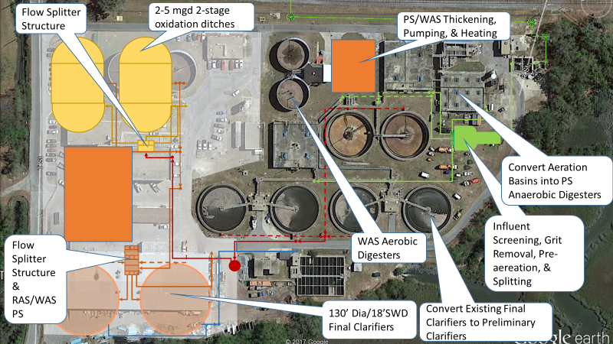
Wastewater: Academy creek improvements overview and cost

Slide 23
Wastewater: Academy creek improvements overview and cost
ACADEMY CREEK WWTP CAPITAL COST SUMMARY
Septage and FOG Receiving | $ 1,500,000
Sitework/Yard Piping/Demolition | $ 5,350,000
Headworks | $ 4,561,529
Odor Control | $ 503,267
Primary Clarifiers | $ 1,550,000
Biological Processes | $ 10,456,215
Secondary Clarifiers | $ 3,009,000
Disinfection | $ 200,000
Biosolids (Dewatering, Digester and Related Improvements) | $ 7,633,584
Electrical and Backup Power, I&C | $ 5,208,326
Chemical Feed Systems | $ 800,000
Reuse Water | $ 250,000
SUBTOTAL | $ 41,021,921
Engineering/Administrative (15%) | $ 6,153,288
General Conditions (12%) | $ 4,922,630
Contingency (25%) | $ 10,255,480
GRAND TOTAL | $ 62,353,320
Operating Cost Savings Estimated at $1.4 million annually
Present value of the annuity is about $53 million at 1.5% (3% interest less 1.5% inflation)
Budget estimate is $62 million

Slide 24
Wastewater: Dunbar WWTP 5 mgd improvements and EXPANSION overview
Headworks
Rehabilitating/Replacing worn and corroded equipment.
Inspect grit classifier to determine if need to repair or replace – more than likely needs replacement
Install odor control system
Influent Pump Station
Construct a flow splitter structure
Install VFDs to address concerns about wetwell capacity concerns
Evaluate existing pumps to see if any maintenance is necessary
Minor rehabilitation of worn equipment should be done
Biological Treatment
Rehabilitate corroded walkway supports, pulley system, and piping; Recoat steel basin
Upgrade air diffuser system
Install air flow meters for blowers and minor repairs for blowers
Replace electrical junction and control boxes

Slide 25
Wastewater: Dunbar WWTP 5 mgd improvements overview
Clarifiers
Replace the existing influent MLSS distribution well with a new flocculating well influent MLSS distribution system
Install New Stamford Baffles and inspect and repair all internals and wiers
Replace existing 4ft scum trough with a full radius scum trough
RAS/WAS
Construct a new RAS/WAS pump station
New structure that would function like a splitter box to receive flows from clarifiers
Replace out of commission pump and rehabilitate existing two pumps
RAS flow re-directed to new aeration basin influent flow splitter box
An additional filter structure similar to the existing structure is required
For the UV system an additional 3 modules need to be installed to meet the additional future flows

Slide 26
WASTEWATER: DUNBAR WWTP 5 MGD EXPANSION COST
Unit Process | Order of Magnitude Estimate of Conceptual Costs ($)
Headworks | $826,133
Influent Pump Station | $124,862
New Influent Splitter Box | $273,760
Aeration Basins & Blowers | $387,778
New 3-Stage BNR Process Equipment/Mods | $145,400
New Lime/Alum Storage/Feed Systems | $349,800
Secondary Clarifiers | $430,379
New RAW/WAS Splitter Box | $581,111
Effluent Filters | $374,135
Effluent UV System | $169,195
Subtotal | $3,662,553
Contractor Markups | $974,239
Total Construction Costs | $4,636,792
Contingency (15% | $700,000
Engineering and Administration (15%) | $695,519
Total Project Costs | $6,032,311
Budget Estimate is $6 million

Slide 27
The bottom line is that we need to invest in bgcjwsc
 | Estimated Cost | Year 1 | Year 2 | Year 3 | Year 4 | Year 5 | Year 6 | Year 7 | Year 8 | Year 9 | Year 10 | Total
Water Treatment
Ground Storage Tanks* | $6 |  |  |  |  |  |  |  |  |  |  | $6.0
Eliminate Flooding at Wells |  | $0.21 | $0.21 | $0.21 | $0.21 | $0.21 |  |  |  |  |  | $1.1
Implement SCADA |  | $0.17 | $0.17 | $0.17 | $0.17 | $0.17 |  |  |  |  |  | $0.9
Backup Power |  | $0.50 | $0.50 | $0.50 | $0.50 | $0.50 |  |  |  |  |  | $2.5
Water Distribution
Renewal and Replacement |  | $3 | $3 | $3 | $3 | $3 | $3 | $3 | $3 | $3 | $3 | $30.0
Wastewater Treatment
Academy Creek WWTP | $62 |  |  |  |  |  |  |  |  |  |  | $62.0
Dunbar WWTP | $6 |  |  |  |  |  |  |  |  |  |  | $6.0
Wastewater Collection/Pumping
SCADA and Communications |  | $0.41 | $0.41 | $0.41 | $0.41 | $0.41 |  |  |  |  |  | $2.1
Eliminate Flooding at Pump Sta. |  | $0.96 | $0.96 | $0.96 | $0.96 | $0.96 |  |  |  |  |  | $4.8
Infiltration/Inflow and R&R |  | $3 | $3 | $3 | $3 | $3 | $3 | $3 | $3 | $3 | $3 | $30.0
Odor Control* | $1.20 |  |  |  |  |  |  |  |  |  |  | $1.2
SUBTOTALS | $75.2 | $8.3 | $8.3 | $8.3 | $8.3 | $8.3 | $6.0 | $6.0 | $6.0 | $6.0 | $6.0 | $146.5
SPLOST PROJECTS | $21.0 |  |  |  |  |  |  |  |  |  |  | $21.0
MASTERPLAN PROJECTS** |  | $20.8 | $20.8 | $20.8 | $20.8 | $20.8 | $20.8 | $20.8 | $20.8 | $20.8 | $20.8 | $208.0
GRAND TOTAL FOR BGCJWSC | $96.2 | $29.1 | $29.1 | $29.1 | $29.1 | $29.1 | $26.8 | $26.8 | $26.8 | $26.8 | $26.8 | $375.5
** Masterplan projects are expected to continue for 30 years |  |  |  |  |  |  |  |  | * Delaying until $ are available

Slide 28
Deficit if we pursue the current path
NO CHANGE FROM CURRENT FINANCIAL POSITION
 | Estimated Cost | Year 1 | Year 2 | Year 3 | Year 4 | Year 5 | Year 6 | Year 7 | Year 8 | Year 9 | Year 10 | Total
AVAILABLE FUNDS |  | $1.6 | $1.6 | $1.6 | $1.6 | $1.6 | $1.6 | $1.6 | $1.6 | $1.6 | $1.6 | $16.0
GRAND TOTAL FOR BGCJWSC | $96.2 | $29.1 | $29.1 | $29.1 | $29.1 | $29.1 | $26.8 | $26.8 | $26.8 | $26.8 | $26.8 | $375.5
SURPLUS/(DEFICIT) | ($96.2) | ($27.5) | ($27.5) | ($27.5) | ($27.5) | ($27.5) | ($25.2) | ($25.2) | ($25.2) | ($25.2) | ($25.2) | ($359.5)
** OPERATIONS AND MAINTENANCE (O&M) COSTS WILL CONTINUE TO INCREASE

Slide 29
Action requested
Approval for immediate projects for about $89 million
Academy Creek WWTP at $62 million
Dunbar WWTP at $6 million
SPLOST projects at $21 million
Consideration of additional revenue options
CDBG and CDBG-DR
FEMA
State Appropriations
Other revenues

Slide 30
ATTRIBUTES: Water resource sustainability and customer satisfaction
Attributes can be: water resource sustainability and customer satisfaction
Practice area: permit compliance for collection systems
Measure: number of SSO events annually and improve year over year
Measure: Investment in R&R
Goals – Department
Measure: Progress towards replacing failing assets (pipelines and lift stations)

Slide 31
Simple process with 2 meetings developed strategic plan FRAMEWORK
Meeting 1
Review functions with each division
Develop SWOT analysis
Consider objectives and goals
Meeting 2 and Post Meeting
Develop metrics
Align metrics to practice areas
Align practice areas to attributes under EUM
Generate a final report

